Slide 2
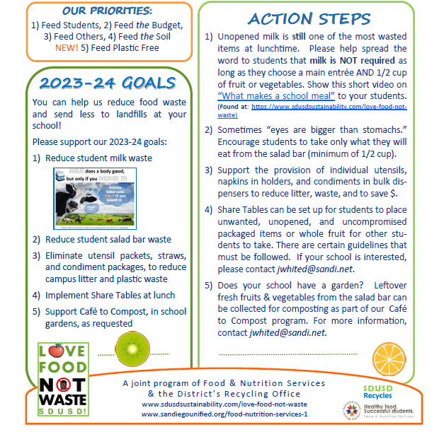

Slide 3
🎵Let’s begin by tapping the beat and warming up our voices by humming.

Slide 4
SDUSD Cafeteria sorting song
to the tune of “Frere Jacques”
success criteria:
Only take milk
if you drink it.
If you never open it,
feed others.
learning intention:
learning intention:
Principle 1 - People Depend on Natural Systems
This is important because :
Concept A. The goods produced by natural systems are essential to human life and to the functioning of our economies and cultures.

Slide 5
SDUSD Cafeteria sorting song
to the tune of “Frere Jacques”
success criteria:
Empty cartons
recycle.
Drain out all the liquid
carefully.
learning intention:
learning intention:
Principle 2 - People Influence Natural Systems
This is important because :
Concept A. Direct and indirect changes to natural systems due to the growth of human populations and their consumption rates influence the geographic extent, composition, biological diversity, and viability of natural systems.

Slide 6
SDUSD Cafeteria sorting song
to the tune of “Frere Jacques”
success criteria:
Only choose plants
that you’ll eat.
One fistfull is enough.
Eat what you choose.
learning intention:
learning intention:
Principle 1 - People Depend on Natural Systems
This is important because :
Concept C. That the quality, quantity, and reliability of the goods and ecosystem services provided by natural systems are directly affected by the health of those systems.

Slide 7
SDUSD Cafeteria sorting song
to the tune of “Frere Jacques”
success criteria:
Fruits and veggies
have peels & cores
that can be composted.
Feed the soil.
learning intention:
learning intention:
Principle 4 - There are no Permanent or Impermeable Boundaries that Prevent Matter from Flowing Between Systems
This is important because :
Concept B. The byproducts of human activity are not readily prevented from entering natural systems & may be beneficial, neutral, or detrimental in their effect.

Slide 8
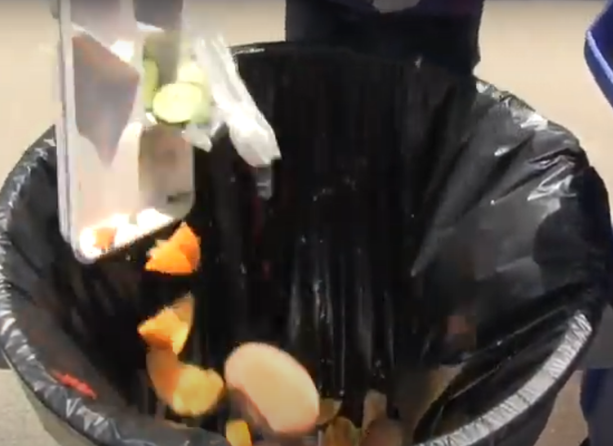
SDUSD Cafeteria sorting song
to the tune of “Frere Jacques”
success criteria:
Empty food trays
recycle.
Whack ev’rything off trays.
Match the shapes.
learning intention:
learning intention:
Principle 2 - People Influence Natural Systems
This is important because :
Concept D. The legal, economic, and political systems that govern the use and management of natural systems directly influence the geographic extent, composition, biological diversity, and viability of natural systems.

